Slide 1
FACE-MASK DETECTION
TEAM MEMBERS :
SRINIVASAN H - 20MIS1078
FATHIMA NOOHU NISHA M - 20MIS1147
SUGANESHWARAN M -20MIS1093

Slide 2
INTRODUCTION:
The spread of COVID-19 has resulted in more than 1,841,000 global deaths and more than 351,000 deaths in the US by Dec. 31, 2020 [1]. The spread of the virus can be avoided by mitigating the effect of the virus in the environment or preventing the virus transfer from person to person by wearing face masks. WHO defined physical distancing as keeping at least six feet or two meters distance from others and recommended that keeping the physical distance and wearing a face mask can significantly reduce transmission of the COVID-19 virus. Like other sectors, the construction industry has been affected, where unnecessary projects have been suspended or mitigated by people's interaction. However, many infrastructure projects cannot be suspended due to their crucial role in people's life. Therefore, bridge maintenance, street widening, highway rehabilitation, and other essential infrastructure projects have been activated again to keep the transportation system's serviceability. Although infrastructure projects are activated, the safety of construction workers cannot be overlooked. Due to the high density of workers in construction projects, there is a high risk of infection spread in construction sites. Therefore, systematic safety monitoring in infrastructure projects that ensure maintaining the physical distance and wearing face masks can enhance construction workers' safety. In some cases, safety officers can be assigned to infrastructure projects to inspect workers to detect cases that either social distancing or face mask-wearing is not satisfied. However, once there are so many workers on a construction site, it is difficult for the officers to determine hazardous situations. Also, assigning safety officers increases the number of people on-site, raising the chance of transmission even more, and putting workers and officers in a more dangerous situation. Recently, online video capturing in construction sites has become very common. Drones are used in construction projects to record online videos to manage worksites more efficiently. The current system of online video capturing can be used for safety purposes. An automatic system that uses computer vision techniques to capture real-time safety violations from online videos can enhance infrastructure project workers' safety. This study develops a model using Faster R-CNN to detect workers who either don't wear a face mask on road projects. Once a safety violation occurs, the model highlights who violates the safety rules by a red box in the video.

Slide 3
LITERATURE SURVEY:
Object detection problems aim to locate and classify objects in an image. The face mask and physical distance detection are classified as object detection problems. Object detection algorithms have been developing in the past two decades. Since 2014, deep learning usage in object detection has driven remarkable breakthroughs, improving accuracy and detection speed. Object detection is divided into two categories. One-stage detection, such as You Only Look Once (YOLO), and two-stage detection, such as Region-Based Convolutional Neural Networks (R-CNN). Two-stage detectors have higher localization and object recognition accuracy, while the one-stage detectors achieve greater inference speed [14]. R-CNN or regions with CNN features (R-CNNs), introduced by Girshick. It implements four steps; First, it selects several regions from an image as object candidate boxes, then rescales them to a fixed size image. Second, it uses CNN for feature extraction of each region. Finally, the features of each region are used to predict the category of boundary boxes using the SVM classifier. However, feature extraction of each region is resource-intensive and time-consuming since candidate boxes have overlap, making the model perform repetitive computation. Fast R-CNN handles the issue by taking the entire image as the input to CNN to extract features. Faster R-CNN speeds up the R-CNN network by replacing selective search with a Region Proposal Network (RPF) to reduce the number of candidate boxes. Faster R CNN is a near-real-time detector. Face mask detection identifies whether a person is wearing a mask or not in a picture. Since the beginning of the COVID-19 pandemic, studies have been conducted to detect face masks and employed a one-stage detector, called RetinaFaceMask, that used a feature pyramid network to fuse the high-level semantic information. They added an attention layer to detect the face mask faster in an image. They achieved a higher accuracy of detection compared with previously developed models.

Slide 4
METHODOLOGY:
Packages to be used:
Tensorflow>=2.7.0
Keras==2.7.0
Imutils==0.5.3
Numpy==1.21.4
Opencv-python==4.5.4.58
Matplotlib==3.2.1
Scipy==1.4.1

Slide 5
ABOUT DATASET:
A part of the dataset of face masks was obtained from the Kaggle website(
https://www.kaggle.com/omkargurav/face-mask-dataset?select=data ) which contains 2,883 images that each image includes one or multiple normal faces with various illumination and poses. The images are already annotated with faces with a mask, without mask-wearing. To increase the training data 1,000 other images with their annotations were added to the database. A total of 3,883 images was used as the facemask dataset. Figure 1, shows the dataset obtained from the Kaggle website. Some samples of images with their annotations are illustrated in Figure 2, where three types of face mask-wearing are annotated including a correct face mask-wearing and without a face mask.

Slide 6
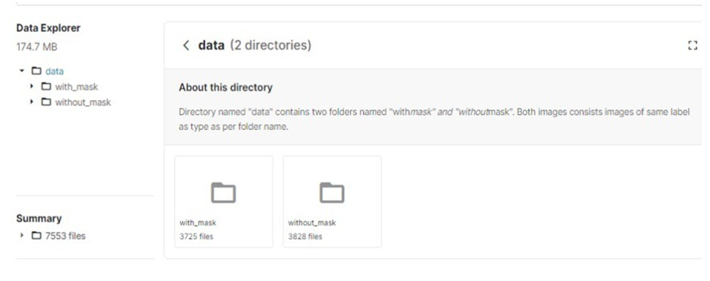

Slide 7
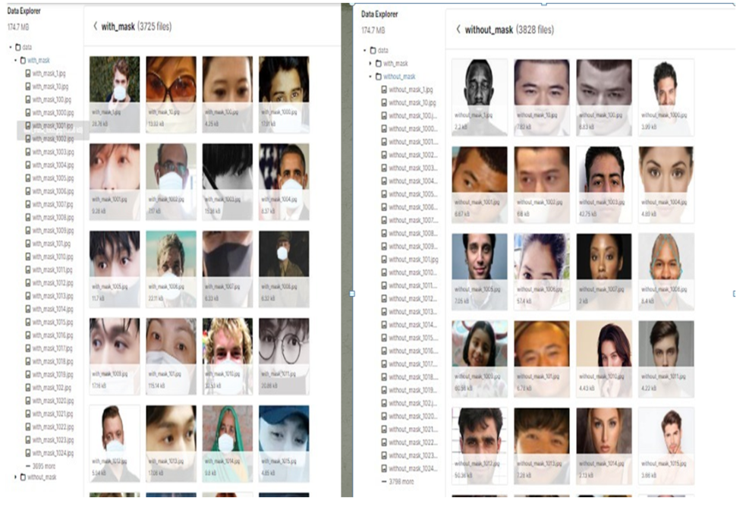

Slide 8
Hardware & Software:
For hardware we need a web cam to detect the real image.
Software – We developed this face mask detector using python – Tensorflow, Keras, OpenCv and other libraries by using faster rcnn model for detection

Slide 9
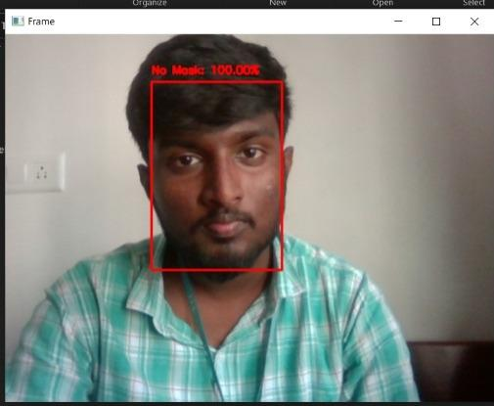
Experiment Result:
Without mask & With mask

Slide 10
Conclusion and future work:
This paper developed a model to detect face mask-wearing and workers to assure their safety
in the COVID-19 pandemic. The paper found a facemask dataset including images of people
with masks, without masks, and incorrect mask-wearing. To increase the training dataset, 1,000
images with different types of mask-wearing were collected and added to the dataset to create a
dataset with 2,883 images. A Faster R-CNN Inception ResNet V2 network was chosen among
different models that yielded an accuracy of 99.8% for face mask detection. To choose a base
model, we assessed the measurements like precision, accuracy, and recall and chose
MobileNetV2 architecture with the best exhibition having 99% precision and 99% recall. It is
additionally computationally efficient using Faster R-CNN which makes it simpler to introduce
the model to inserted frameworks.

Slide 11
REFERENCES:
Z. Zou, Z. Shi, Y. Guo, and J. Ye, “Object Detection in 20 Years: A Survey,” 2019,
Accessed: Aug. 02, 2020. [Online]. Available: http://arxiv.org/abs/1905.05055.
2. R. Girshick, “Fast R-CNN,” 2015. Accessed: Aug. 03, 2020. [Online]. Available:
https://github.com/rbgirshick/
3. Changjin Li, Jian Cao, and Xing Zhang. 2020. Robust Deep Learning Method to Detect
Face Masks. In Proceedings of the 2nd International Conference on Artificial Intelligence and
Advanced Manufacture (AIAM2020). Association for Computing Machinery, New York, NY, USA, 74–77. DOI:https://doi.org/10.1145/3421766.34217
4. https://www.kaggle.com/omkargurav/face-mask-dataset?select=data

